Slide 1



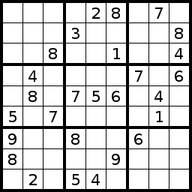
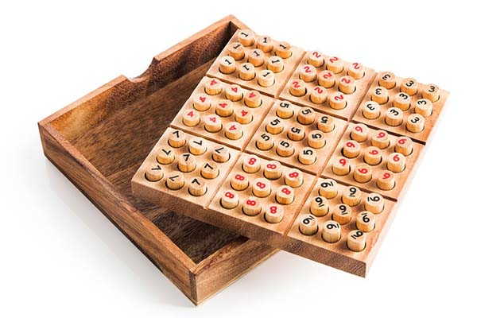


Slide 4
SUDOKU
The name “Sudoku” can be broken down into “Su” which means “Number” and “Doku” which means “Single/Only.”
As such, the translation of the game’s name means “single numbers only.”
While the name “Sudoku” comes from Japan, the Japanese actually call it by its original name, which is “Number Place.”

Slide 5
HEALTH BENEFITS
If you did not already know it, Sudoku is a fun game that is great as a mental workout . If you are looking for a game that can prove to get easier over time and present a challenge for your mental capacity, Sudoku is it. Whether you are young or old, this game offers the opportunity to occupy your mind while it provides a variety of other physical and mental health benefits too.

Slide 6
Sudoku is, arguably one of few good addictions to have.
It is known to offer its aficionados the following health benefits:
Exercise for the brain, along with alertness, which helps with mental development.
Concentration
Goal setting,
Reduced emotional over-thinking and panic or anxiety,
Focused mind
Patience,
Sense of achievement etc.

Slide 7
WHAT IS SUDOKU ?
Sudoku requires no calculation or arithmetic skills.
It is essentially a game of placing numbers in squares, using very simple rules of logic and deduction.
It can be played by children and adults and the rules are simple to learn.

Slide 8
OBJECTIVE OF SUDOKU
The objective of the game is to fill all the blank squares in a game with the correct numbers. There are three very simple constraints to follow. In a 9 by 9 square Sudoku game:
Every row of 9 numbers must include all digits 1 through 9 in any order
Every column of 9 numbers must include all digits 1 through 9 in any order
Every 3 by 3 subsection of the 9 by 9 square must include all digits 1 through 9
Similarly, smaller Sudoku puzzles, such as the 4 x 4 puzzle, must have the numerals
1 through 4 in each row, column and subsection.
Larger Sudoku games (16 by 16) must have numerals 1 through 16 in each row, column and region. The principles are the same whatever the size of the game.

Slide 9
OBJECTIVE OF SUDOKU
Every Sudoku games begins with a number of squares already filled in and the difficulty of each game is largely a function of how many squares are filled in.
The more squares that are known, the easier it is to figure out which numbers go in the open squares. As you fill in squares correctly, options for the remaining squares are narrowed and it becomes easier to fill them in.
Sudoku's are usually categorised as easy, medium or hard.

Slide 10
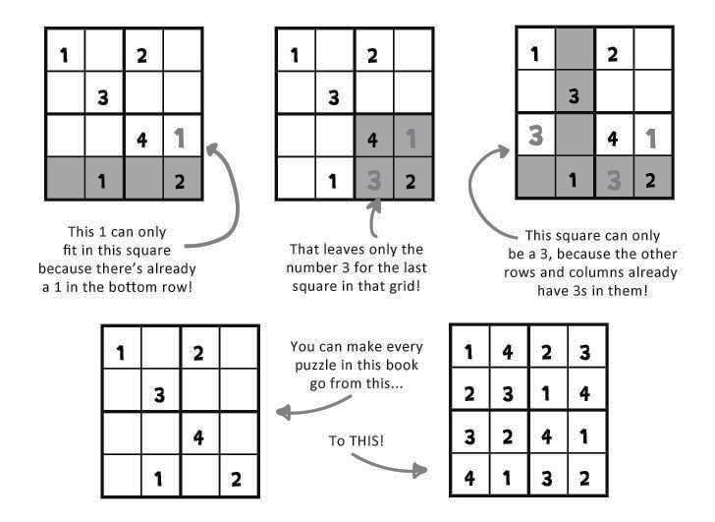
4 X 4 SUDOKU

Slide 11
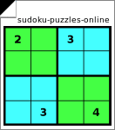
4 X 4 SUDOKU

Slide 12
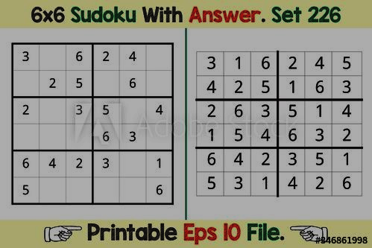
6 X 6 SUDOKU

Slide 13
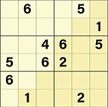
6 X 6 SUDOKU

Slide 14
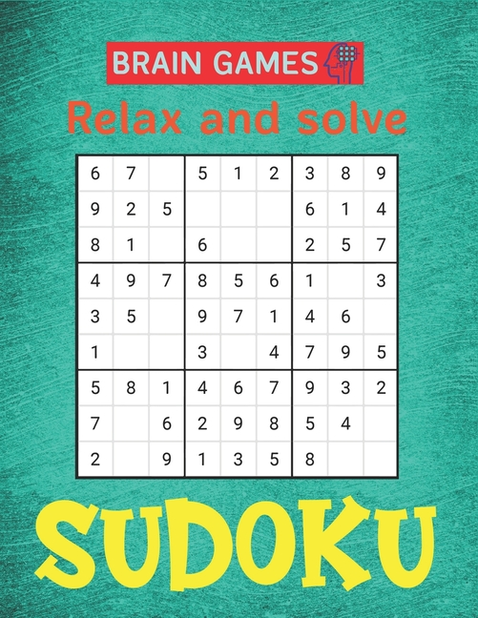
9 X 9 SUDOKU

Slide 15
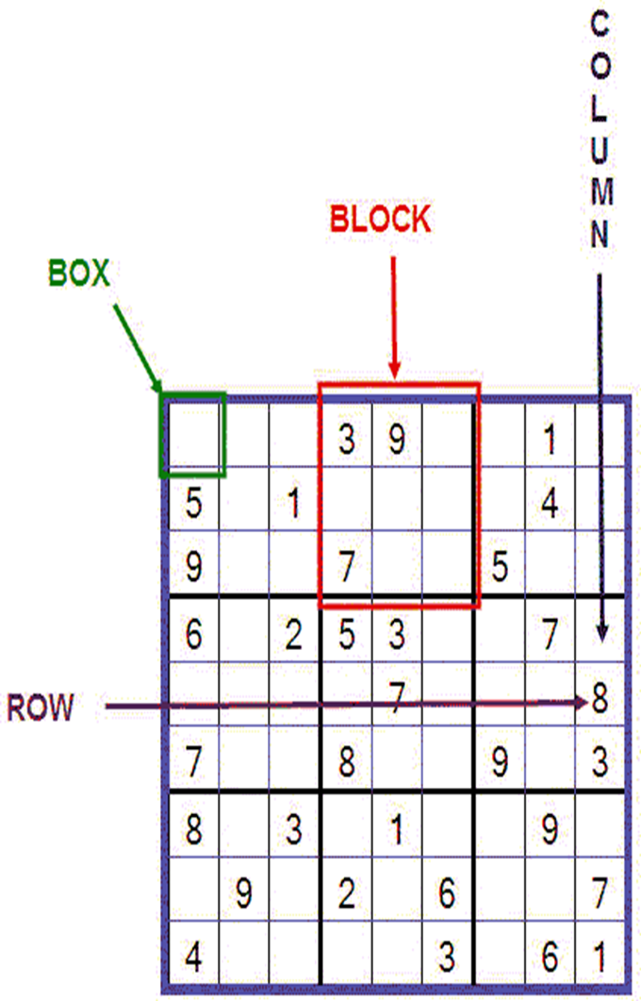

Slide 16
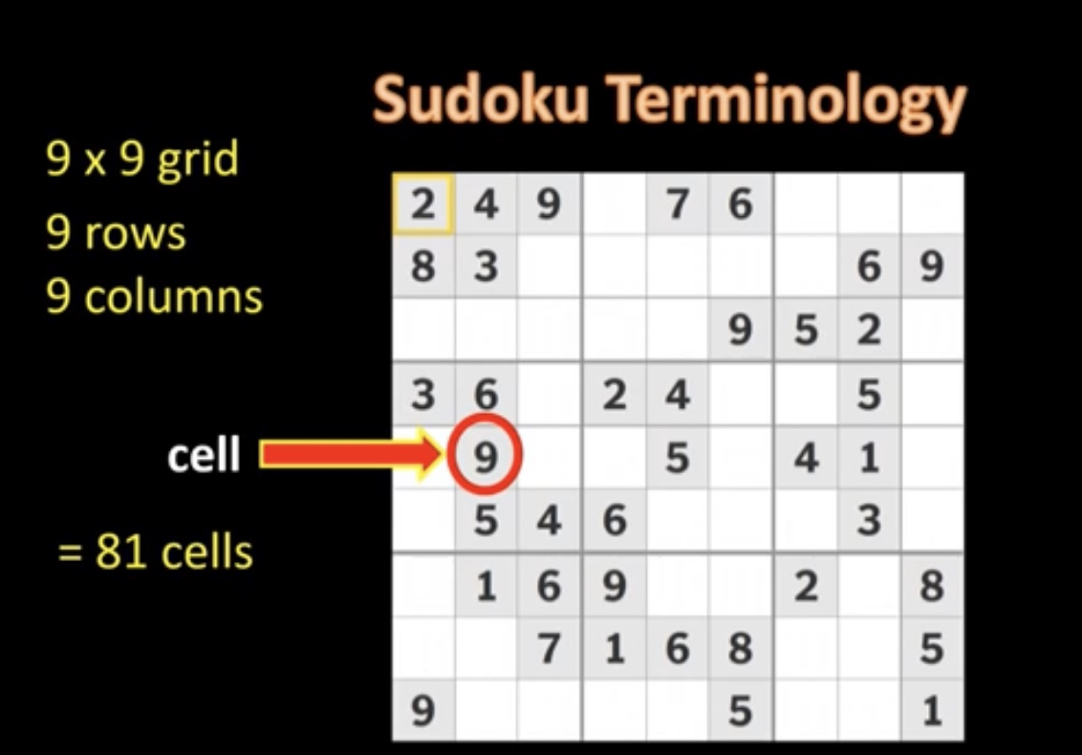

Slide 17
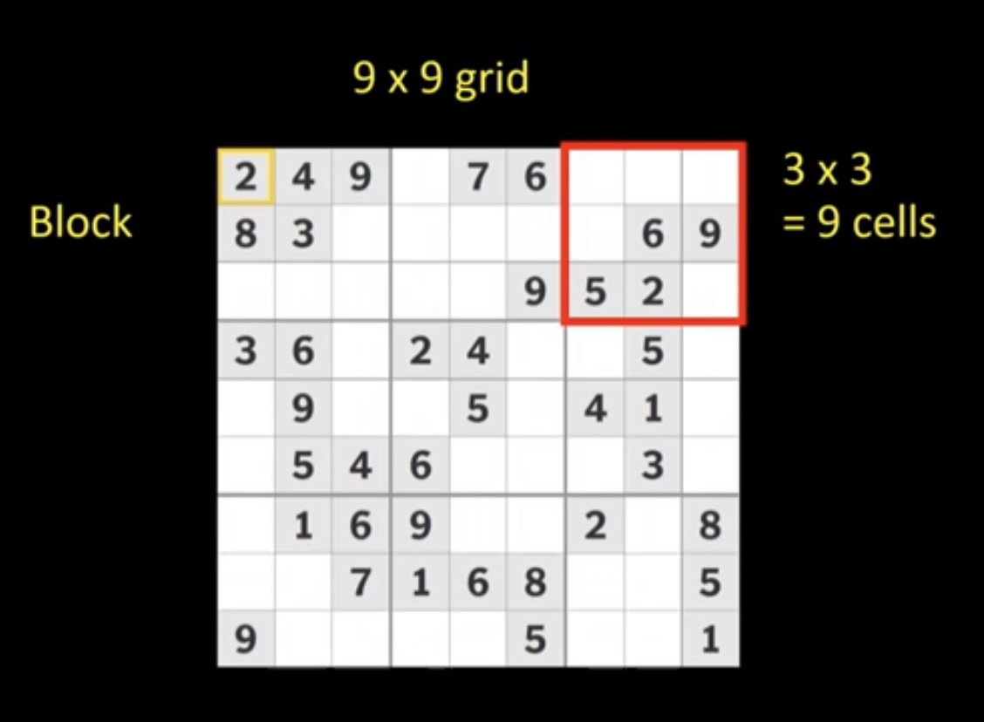

Slide 18
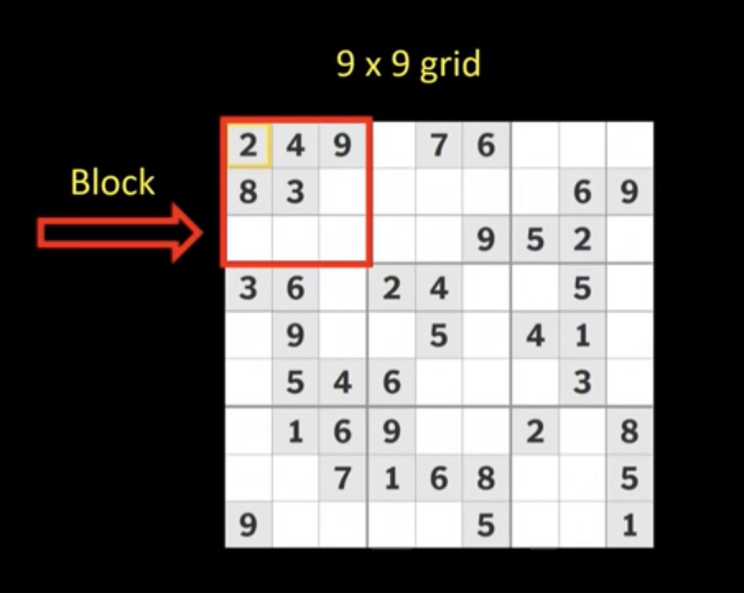

Slide 19
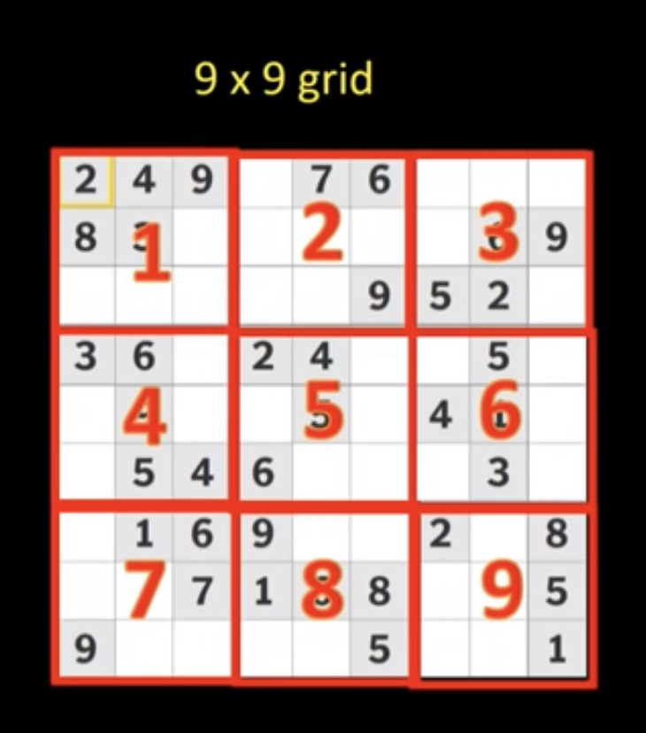

Slide 20
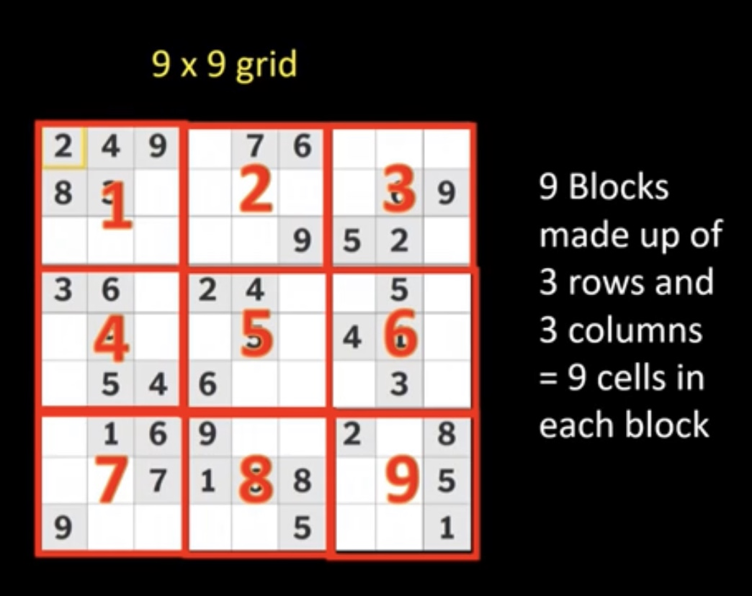

Slide 21
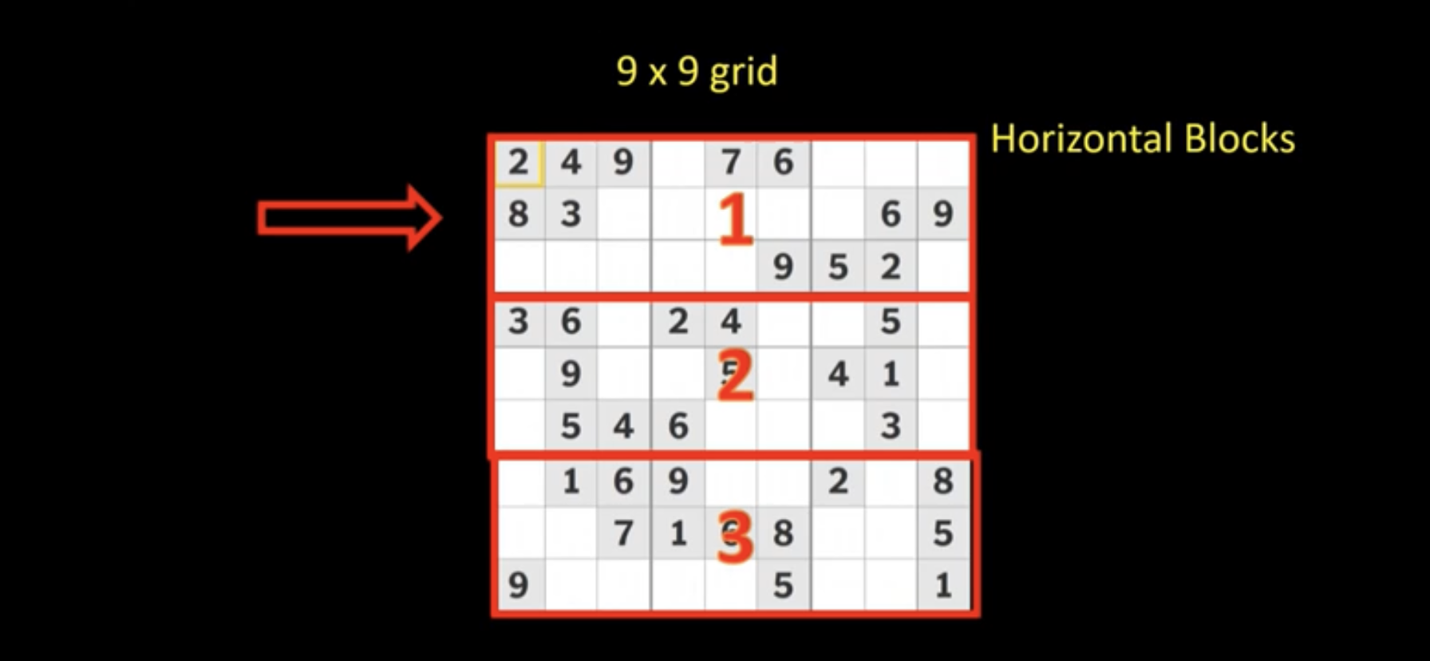

Slide 22
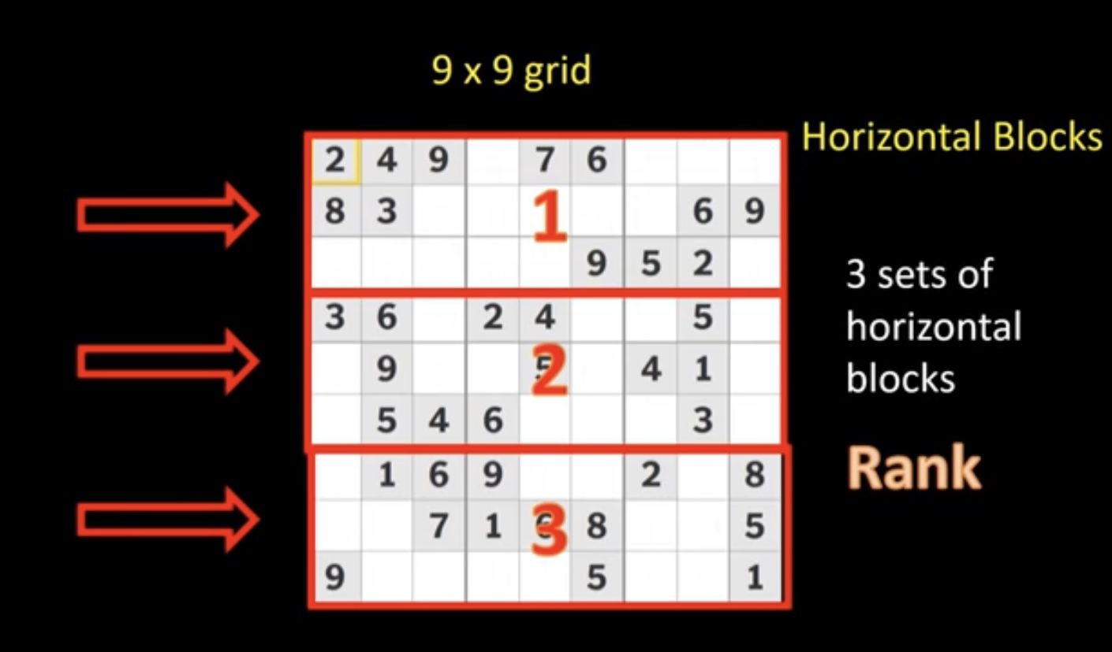

Slide 23
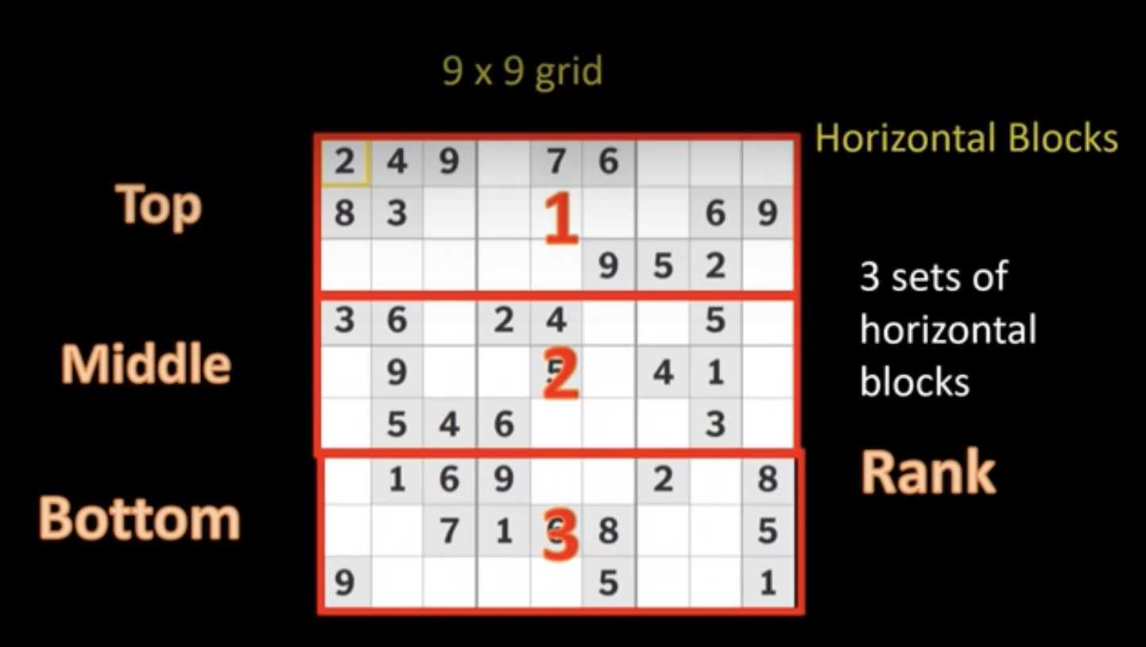

Slide 24
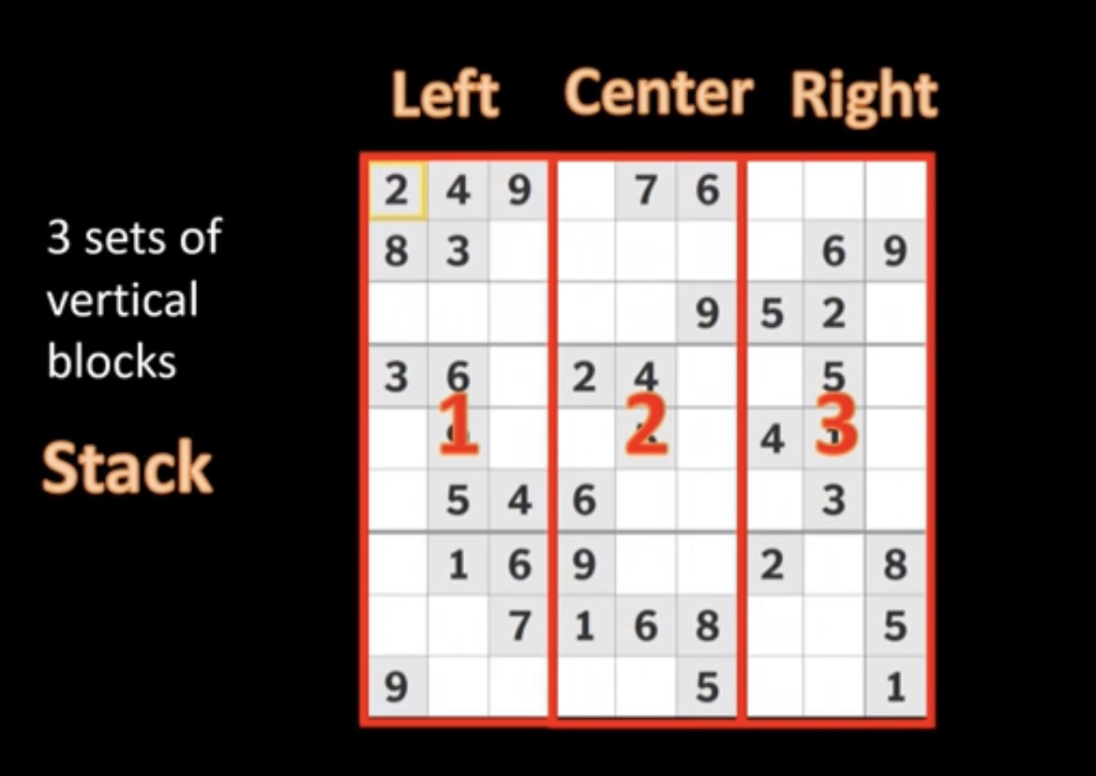

Slide 25
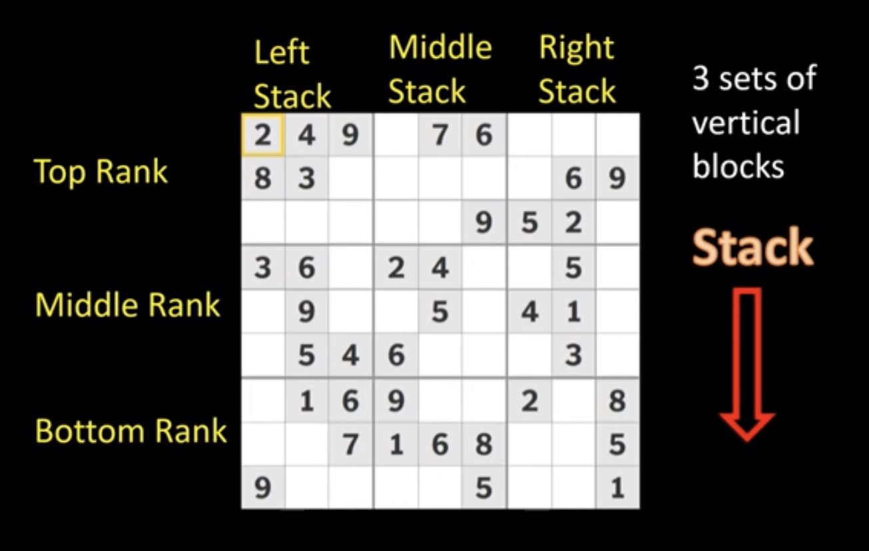

Slide 26
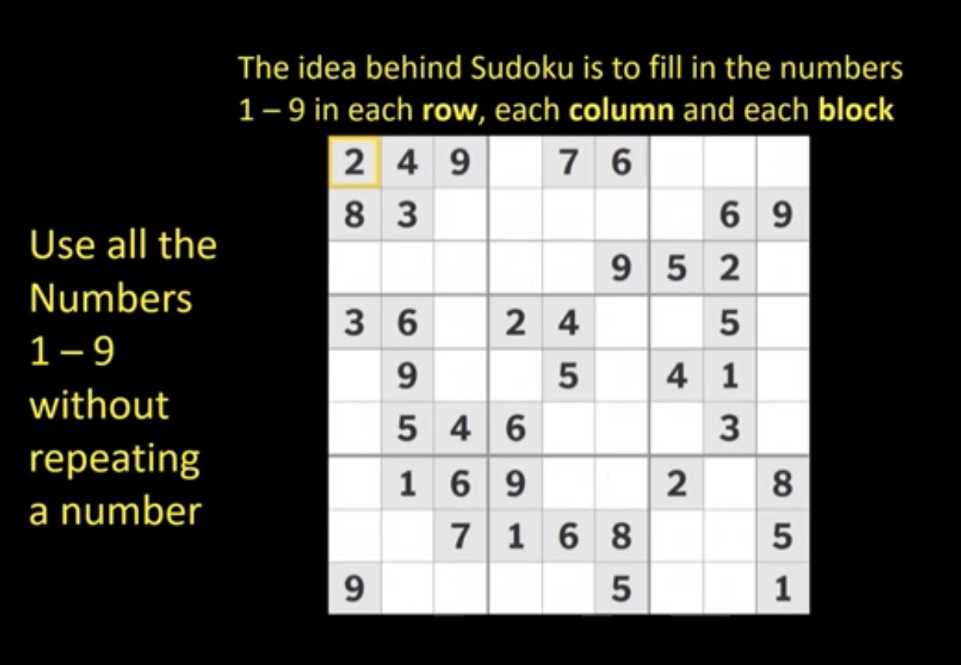

Slide 27
HOW TO PLAY SUDOKU
The first things to do in tackling a Sudoku puzzle is to scan the rows and columns to see where a certain number might go.

Slide 29

INCORRECT
SORRY, TRY AGAIN!
YOU CAN DO IT!

Slide 30

CORRECT
WELL DONE!
YOUR A SUDOKU PRO!

Slide 31
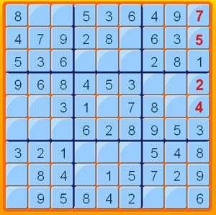
Let’s play sudoku

Slide 32
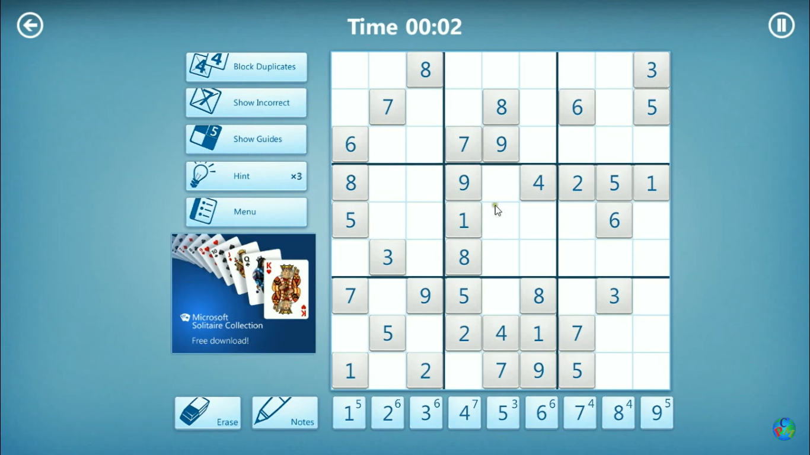

Let’s play sudoku

Slide 33


Slide 34

 | 9 | 3 | 1 |  | 5 | 6 | 4
7 |  |  |  |  |  |  | 1 | 5
5 |  | 1 | 2 |  | 9 | 3 |  | 7
2 |  |  |  |  |  |  |  | 3
 | 3 | 6 | 9 |  | 7 | 5 | 2
9 |  |  |  |  |  |  |  | 1
3 |  | 2 | 4 |  | 8 | 1 |  | 9
6 |  |  |  |  |  |  |  | 4
 | 4 | 7 | 3 |  | 2 | 8 | 5
What number would go in the YELLOW square?

Slide 35

 | 9 | 3 | 1 |  | 5 | 6 | 4
7 |  |  |  |  |  |  | 1 | 5
5 |  | 1 | 2 |  | 9 | 3 |  | 7
2 |  |  |  |  |  |  |  | 3
 | 3 | 6 | 9 |  | 7 | 5 | 2
9 |  |  |  |  |  |  |  | 1
3 |  | 2 | 4 |  | 8 | 1 |  | 9
6 |  |  |  |  |  |  | 3 | 4
 | 4 | 7 | 3 |  | 2 | 8 | 5
See if you can complete the rest of the Sudoku!

Slide 36
 | 9 | 3 | 1 |  | 5 | 6 | 4
7 |  |  |  |  |  |  | 1 | 5
5 |  | 1 | 2 |  | 9 | 3 |  | 7
2 |  |  |  |  |  |  |  | 3
 | 3 | 6 | 9 |  | 7 | 5 | 2
9 |  |  |  |  |  |  |  | 1
3 |  | 2 | 4 |  | 8 | 1 |  | 9
6 |  |  |  |  |  |  | 3 | 4
 | 4 | 7 | 3 |  | 2 | 8 | 5
See if you can complete the rest of the Sudoku!

Slide 37
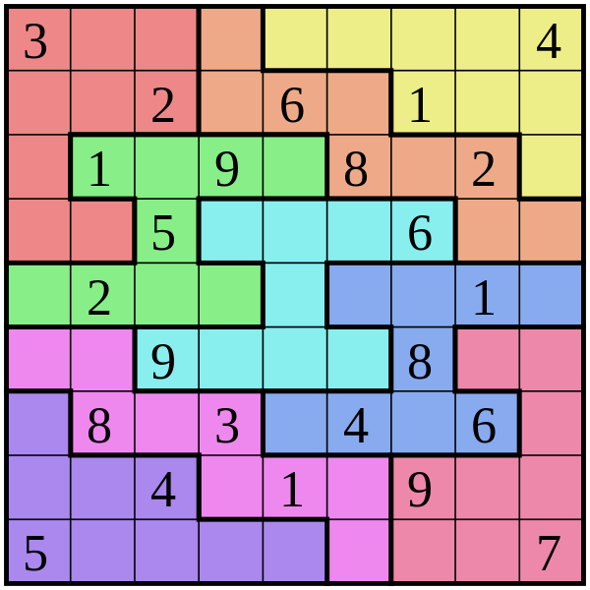
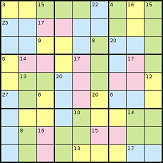
This Photo by Unknown Author is licensed under CC BY-SA

Slide 38
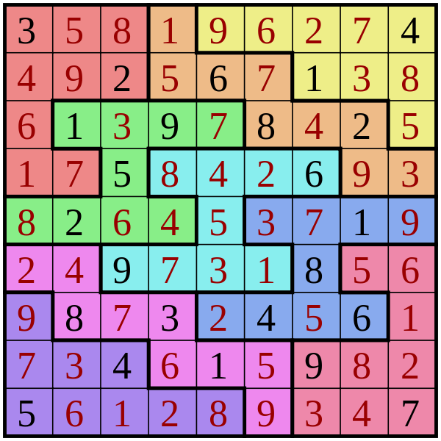
ANSWER

Slide 39
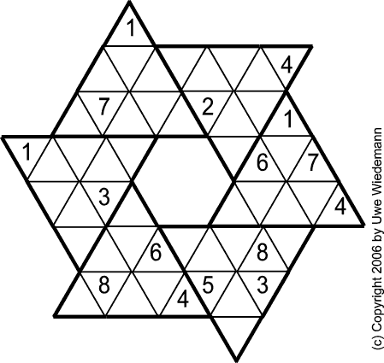

Slide 41

SUDOKU SITES
Here are a few Sudoku Websites that you can practice some more:
www.websudoku.com
www.sudokufun.com
www.dailymail.co.uk/coffeebreak/puzzles/sudoku.html
Hopefully now you will be able to complete a Sudoku by yourself, either online, or in the paper or it
might even tempt you to purchase a Sudoku Book (who knows!)

Slide 42



Slide 43


